Slide 1
Complex Calculator
By:
Tisi Andrea
Salzano Simone
Montervino Dario
Spremulli Michele

Slide 2

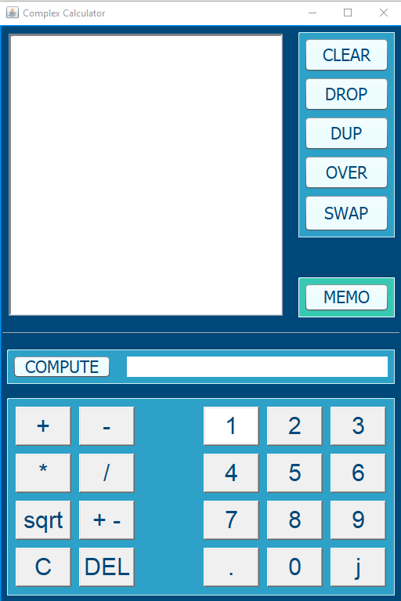
OUR GUI

Slide 3
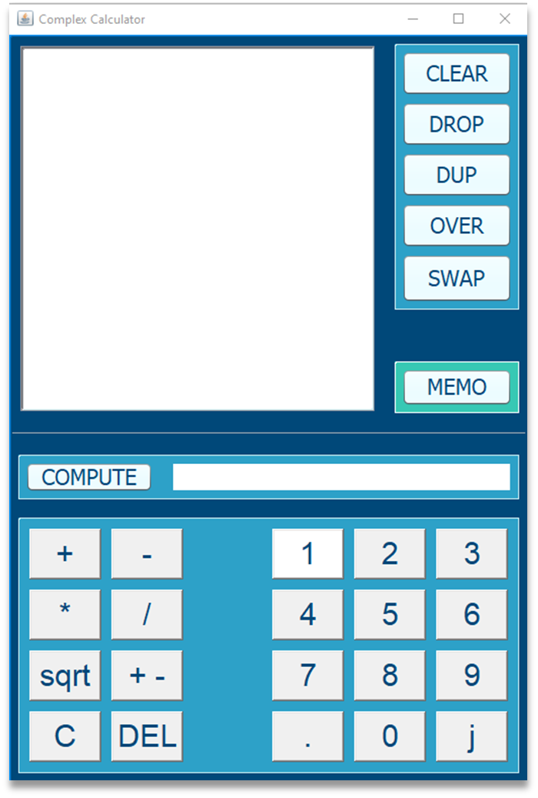
MEMORY MANIPULATION
SWAP
OVER
DUP
DROP
CLEAR

Slide 4
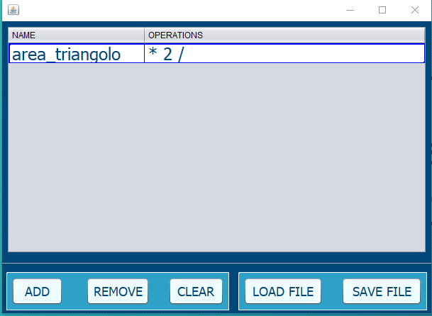
PERSONALIZED OPERATIONS
Save your personalised operation and run it whenever you want!!

Slide 5
LET’S TRY THIS

